Slide 1

ICT-5405
PROJECT MANAGEMENT AND QUALITY ASSURANCE
01
Agile Software Development

Slide 2
What is Agile?
Agile is used to denote the ability of Agile Methods to respond to changing requirement in a controlled but flexible manner.
Key term IID –
The simple ability to revisit the “phases” of development dramatically improves project efficiency.
The idea of revisiting phases over and over is called “incremental and iterative development” (IID).
The development lifecycle is cut up into increments or “iterations” and each iteration touches on each of the traditional “phases” of development.
Agile methodologies can equip experienced Project Managers with new tools to manage projects that are set in environments of constant change.

Slide 3
Agile Software Development
Agile software development is a conceptual framework for software engineering that promotes development iterations throughout the life-cycle of the project.
Software developed during one unit of time is referred to as an iteration, which may last from one to four weeks.
Agile methods also emphasize working software as the primary measure of progress.

Slide 4
Why do we need new Project Management Methods?
Information Technology (as well as other industries) are continuously being challenged by emerging technologies and requirements.
Traditional Project Management “Best Practices” suggest that we should lock down requirements and setup a change control system at the beginning.
Traditional Project Management practices also tend to refer back to the original requirements (and/or the contract) when enforcing change control.

Slide 5
Traditional Project Management Practices can Lead to….
Chaos – Junior Project Managers tend to either:
allow too much uncontrolled change to take place (to ensure customer satisfaction)
or are too strict in allowing for change (resulting in irate customers).
Winston Royce (of waterfall process fame) later noted that his ideas were incorrectly interpreted and that a “single pass” framework would never work (his article actually advocates at least a second pass).

Slide 6
Traditional Project Management Practices can Lead to….
Dramatic Project Underperformance – According to the Standish Group’s Chaos Reports, only 16 percent of IT projects are successful, the remainder are:
Late.
Over Budget.
Deliver only a fraction of original scope in order to meet budget restrictions.
Cancelled.

Slide 7
What is Different About Agile Methods?
They are all about managing the impact of change on a project.
They allow change to be introduced into a project in a orderly way that attempts to maximize the benefits for the sponsor.
They control the risks that the change introduces.

Slide 8
What is different about Agile Methods?
Iterative and Incremental development that break down development into a number of repeating cycles called Iterations
Short iterations are used to keep the feedback flowing (allowing for increased responsiveness to change and reducing the risk of building the wrong thing).
Open, Flexible and Extensive design using open standards whenever possible

Slide 9
What is different about Agile Methods?
Empowered Teams – Experienced specialists are encouraged to work out the detail design on their own.
Personal Communication – Rather than relying on written documentation to communicate design decisions, technical approaches and other typically documented items, agile method suggest that the team work in the same physical space (co-location). Use of white boards in the work area is encouraged rather than lengthy formal detail design documentation.

Slide 10
Agile manifesto
We are uncovering better ways of developing software by doing it and helping others do it. Through this work we have come to value:
Individuals and interactions over processes and tools
Working software over comprehensive documentation
Customer collaboration over contract negotiation
Responding to change over following a plan
That is, while there is value in the items on the right, we value the items on the left more.

Slide 11
Characteristics of Agile Software Development
Light Weighted methodology
Small to medium sized teams
vague and/or changing requirements
vague and/or changing techniques
Simple design
Minimal system into production

Slide 12
The Benefits of Being Agile ..
Reducing Risk – The benefits from improved control and improved communication lead to reduced risks. Examples of risks include:
Risk of building (or doing) the wrong thing. Did the sponsor get what they asked for but not what they actually wanted?
Risk of building the right thing poorly. For example, was the product poorly crafted. Was it thoroughly tested as a part of each iteration? Is the final produce extensible?
Risk of being placed into an endless cycle of design updates and reviews due to changing requirements or high levels of complexity
Relief from continual design revisions -- Agile Methods are of the most benefit when applied to projects where the requirements are either unclear or evolving.

Slide 13
The Benefits of Being Agile -- Improved Control
Agile methods allow the Project Manager to their control over the project in high change environment. Utilizing less rigid, yet structured agile methodologies, control is through a number of mechanisms.
Frequent delivery of working code allows progress to be objectively measured.
Early and frequent stakeholder feedback allows the Project Manager to redirect project priorities when needed to ensure that real value is delivered.
Misunderstandings are cleared up early in the project life-cycle.

Slide 14
The Benefits of Being Agile (Improved Control) ..
The sponsor is able to end the project earlier than scheduled and still receive value.
Short daily meetings allow team members to share both successes and problems with each other. Each team member should share:
What they have just completed (so that team members working on dependent tasks are notified).
What are they going to work on next (allows other team members to contribute information that may be helpful to the task).
Issues that are slowing down or halting their progress (so that other team members and/or the Project Manager can provide assistance).

Slide 15
Agile – Challenges
1. Lack of Agile Knowledge & Experience
Teams unfamiliar with Agile struggle with concepts like sprints, user stories, and continuous delivery.
Requires proper training and mentoring.
2. Poor Team Collaboration
Agile depends on strong communication, but remote teams or siloed departments can make collaboration difficult.
Lack of face-to-face interactions (especially in distributed teams) can impact effectiveness.

Slide 16
Agile – Challenges
3. Customer & Stakeholder Involvement
Agile requires continuous feedback, but stakeholders may not always be available or engaged.
Lack of involvement can lead to mismatched expectations.
4. Inconsistent Documentation
Agile prioritizes working software over extensive documentation, which can cause issues for maintenance or compliance.
New team members may struggle to understand past decisions without proper records.

Slide 17
Existing Agile Methods
Extreme Programming (XP)
Scrum
Crystal Methods
Feature Driven Development
Lean Development
Dynamic Systems Development Methodology (DSDM)

Slide 18
Extreme Programming -- XP
Most prominent Agile Software development method
Prescribes a set of daily stakeholder practices
“Extreme” levels of practicing leads to more responsive software.
Changes are more realistic, natural, inescapable.

Slide 19
eXtreme Programming
Extreme Programming (XP) is an Agile software development methodology that emphasizes high-quality software, frequent releases, and strong collaboration between developers and customers. It is designed to respond to changing requirements efficiently while maintaining high technical standards.

Slide 20
XP values
Communication
Simplicity
Feedback
Courage

Slide 21
Extreme programming practices
Principle or practice | Description
Incremental planning | Requirements are recorded on story cards and the stories to be included in a release are determined by the time available and their relative priority. The developers break these stories into development ‘Tasks’.
Small releases | The minimal useful set of functionality that provides business value is developed first. Releases of the system are frequent and incrementally add functionality to the first release.
Simple design | Enough design is carried out to meet the current requirements and no more.
Test-first development | An automated unit test framework is used to write tests for a new piece of functionality before that functionality itself is implemented.
Refactoring | All developers are expected to refactor the code continuously as soon as possible code improvements are found. This keeps the code simple and maintainable.

Slide 22
Extreme programming practices (b)
Pair programming | Developers work in pairs, checking each other’s work and providing the support to always do a good job.
Collective ownership | The pairs of developers work on all areas of the system, so that no islands of expertise develop, and all the developers take responsibility for all of the code. Anyone can change anything.
Continuous integration | As soon as the work on a task is complete, it is integrated into the whole system. After any such integration, all the unit tests in the system must pass.
Sustainable pace | Large amounts of overtime are not considered acceptable as the net effect is often to reduce code quality and medium term productivity
On-site customer | A representative of the end-user of the system (the customer) should be available full time for the use of the XP team. In an extreme programming process, the customer is a member of the development team and is responsible for bringing system requirements to the team for implementation.

Slide 23
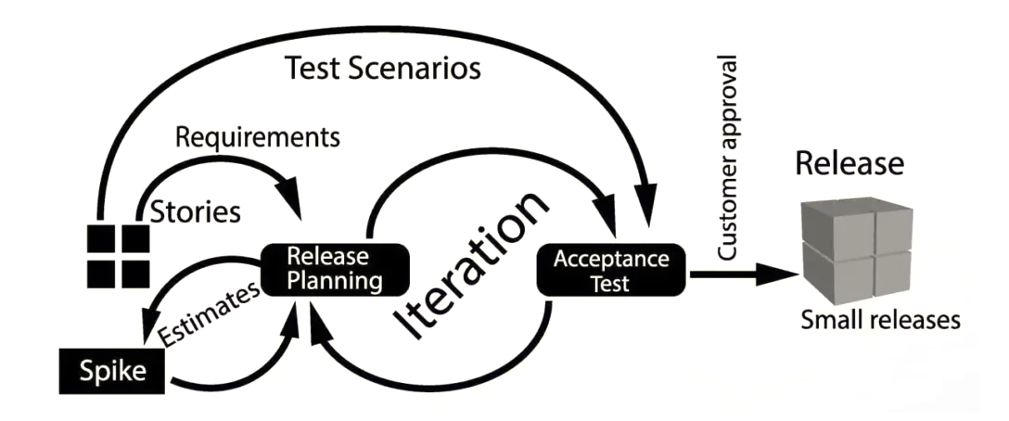
XP Release Cycle

Slide 24
The Planning Game
Business writes a story describing desired functionality
Stories are written on index cards – user stories
Development estimates stories
Velocity determines number of stories per iteration
Business splits and prioritizes stories and determines the composition of releases
Velocity is measured and adjusted every iteration
Customer steers development
Notes:
Big subject: will gloss over it
Release planning & iteration planning

Slide 25
A ‘prescribing medication’ story

Slide 26
Examples of task cards for prescribing medication

Slide 27
Testing
Testing is central to XP and XP has developed an approach where the program is tested after every change has been made.
Unit Tests and Functional Tests
Test a little, code a little…“Test-first programming”
Tests become the specification
Tests give confidence in the system as user is involved
Tests give courage to change the system
Automated test harnesses are used to run all component tests each time that a new release is built.

Slide 28


Test-first development
Writing tests before code clarifies the requirements to be implemented.
Tests are written as programs rather than data so that they can be executed automatically. The test includes a check that it has executed correctly.
Usually relies on a testing framework such as JUnit.
All previous and new tests are run automatically when new functionality is added, thus checking that the new functionality has not introduced errors.

Slide 29
Customer involvement
The role of the customer in the testing process is to help develop acceptance tests for the stories that are to be implemented in the next release of the system.
The customer who is part of the team writes tests as development proceeds. All new code is therefore validated to ensure that it is what the customer needs.
However, people adopting the customer role have limited time available and so cannot work full-time with the development team. They may feel that providing the requirements was enough of a contribution and so may be reluctant to get involved in the testing process.

Slide 30
Test case description for dose checking

Slide 31
Test automation
Test automation means that tests are written as executable components before the task is implemented
These testing components should be stand-alone, should simulate the submission of input to be tested and should check that the result meets the output specification. An automated test framework (e.g. Junit) is a system that makes it easy to write executable tests and submit a set of tests for execution.
As testing is automated, there is always a set of tests that can be quickly and easily executed
Whenever any functionality is added to the system, the tests can be run and problems that the new code has introduced can be caught immediately.

Slide 32
XP testing difficulties
Programmers prefer programming to testing and sometimes they take short cuts when writing tests. For example, they may write incomplete tests that do not check for all possible exceptions that may occur.
Some tests can be very difficult to write incrementally. For example, in a complex user interface, it is often difficult to write unit tests for the code that implements the ‘display logic’ and workflow between screens.
It difficult to judge the completeness of a set of tests. Although you may have a lot of system tests, your test set may not provide complete coverage.

Slide 33

Pair Programming
Two people looking at one machine, with one keyboard and one mouse i.e. on same workstaion.
Two roles:
implementation and strategy
All production code is written in pairs

Slide 34
Pair Programming Benefits
Continuous code review: better design, fewer defects
Confidence to add to or change the system
Discipline to always test and refactor
Teach each other how the system works (reduced staffing risks)
Learn from partner’s knowledge and experience (enhances technical skills)
Notes:
http://members.aol.com/humansandt/papers/pairprogrammingcostbene/pairprogrammingcostbene.htm
(Alistair Cockburn & Laurie Williams)
Partner is a safety net: changing the system is not scary

Slide 35
Simple design
Do the simplest thing that could possibly work
Passes all the tests
No duplicate code
States every intention
Fewest possible classes and methods

Slide 36
XP and change
Conventional wisdom in software engineering is to design for change. It is worth spending time and effort anticipating changes as this reduces costs later in the life cycle.
XP, however, maintains that this is not worthwhile as changes cannot be reliably anticipated.
Rather, it proposes constant code improvement (refactoring) to make changes easier when they have to be implemented.

Slide 37
Refactoring
Programming team look for possible software improvements and make these improvements even where there is no immediate need for them.
This improves the understandability of the software and so reduces the need for documentation.
Changes are easier to make because the code is well-structured and clear.
However, some changes requires architecture refactoring and this is much more expensive.

Slide 38
Refactoring
Design becomes everybody’s daily business
Continuously improve quality of the code
Unit Tests and Pair Programming give courage
Result:
Fast development speed
Code becomes easy to change

Slide 39
Examples of refactoring
Re-organization of a class hierarchy to remove duplicate code.
Tidying up and renaming attributes and methods to make them easier to understand.
The replacement of inline code with calls to methods that have been included in a program library.

Slide 40
Why XP works
Light-weight: discipline without bureaucracy
Under stress, people do what is easiest
All XP practices have short-term benefits as well as long-term benefits
Development as a Conversation
The code is the documentation
XP is fun.

Slide 41
Who benefits from XP?
Programmers:
Customers:
get clear requirements & priorities
can do a good job
can make technical decisions
don’t work overtime
get most business value first
get accurate feedback
can make informed business decisions
can change their mind

Slide 42


Slide 43
What is Scrum?
Definition from rugby football:
A scrum is a way to restart the game after an interruption, where the forwards of each side come together in a tight formation and struggle to gain possession of the ball when it is tossed in among them.

Slide 44
Scrum - an agile process
Scrum approach is a general agile method but its focus is on managing iterative development rather than specific agile practices.
There are three phases in Scrum.
The initial phase is an outline planning phase where you establish the general objectives for the project and design the software architecture.
This is followed by a series of sprint cycles, where each cycle develops an increment of the system.
The project closure phase wraps up the project, completes required documentation such as system help frames and user manuals and assesses the lessons learned from the project.

Slide 45
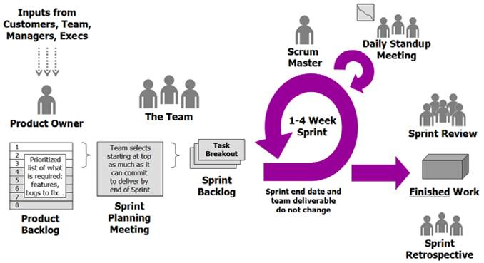
Functionality of Scrum

Slide 46
Components of Scrum
Scrum Roles
The Process
Scrum Artifacts

Slide 47
Scrum Roles: Scrum Master
Represents management to the project
Typically filled by a Project Manager or Team Leader
Responsible for enacting scrum values and practices
Main job is to remove impediments

Slide 48
Scrum Roles: The Scrum Team
Typically 5-10 people
Cross-functional (QA, Programmers, UI Designers, etc.)
Members should be full-time
Team is self-organizing
Membership can change only between sprints

Slide 49
Scrum Roles: Product Owner
Acts like one voice (in any case)
Knows what needs to be build and in what sequence this should be done
Typically a product manager

Slide 50
The Process
Sprint Planning Meeting
Sprint
Daily Scrum
Sprint Review Meeting

Slide 51
1. Sprint Planning Meeting
A collaborative meeting in the beginning of each Sprint between the Product Owner, the Scrum Master and the Team
Takes 8 hours and consists of 2 parts
before lunch and after lunch

Slide 52
Parts of Sprint Planning Meeting
1st Part:
Creating Product Backlog
Determining the Sprint Goal.
Participants: Product Owner, Scrum Master, Scrum Team
2nd Part:
Participants: Scrum Master, Scrum Team
Creating Sprint Backlog

Slide 53
Pre-Project/Kickoff Meeting
A special form of Sprint Planning Meeting
Meeting before the begin of the Project

Slide 54
2. Sprint
A month-long iteration, during which is incremented a product functionality
No outside influence can interference with the Scrum team during the Sprint
Each Sprint begins with the Daily Scrum Meeting

Slide 55
3. Daily Scrum
Is a short (15 minutes long) meeting, which is held every day before the Team starts working
Participants: Scrum Master (which is the chairman), Scrum Team
Every Team member should answer on 3 questions

Slide 56
Questions
What did you do since the last Scrum?
What are you doing until the next Scrum?
What is stopping you getting on with the work?

Slide 57
Daily Scrum
Is NOT a problem solving session
Is NOT a way to collect information about WHO is behind the schedule
Is a meeting in which team members make commitments to each other and to the Scrum Master
Is a good way for a Scrum Master to track the progress of the Team

Slide 58
4. Sprint Review Meeting
Is held at the end of each Sprint
Business functionality which was created during the Sprint is demonstrated to the Product Owner
Informal, should not distract Team members of doing their work

Slide 59
Scrum Artifacts
Scrum artifacts help ensure your team accomplishes what it needs to within each project sprint and for the final project deliverable. The three artifacts of Scrum enable you to identify and document the work that must be done for the project to be successful.
These artifacts capture essential information about what your team must complete and where their priorities lie.
The three Scrum artifacts are:
Product backlog
Sprint backlog
Product increment

Slide 60
Product Backlog
A product backlog is a list of all the things that are required in the product and it is a dynamic and best understood requirements for any changes to be made to the product.
Product backlog owned by the Product Owner (PO) which consists of a lists all features, functions, requirements, enhancements, and fixes that constitute the changes to be made to the product in the future releases.
Typically, the requirements of a product keep changing, i.e. change in business requirements, market conditions, or technology. Thus, product backlog is consistently updated to reflect what the product needs to be most useful to the target users.

Slide 61
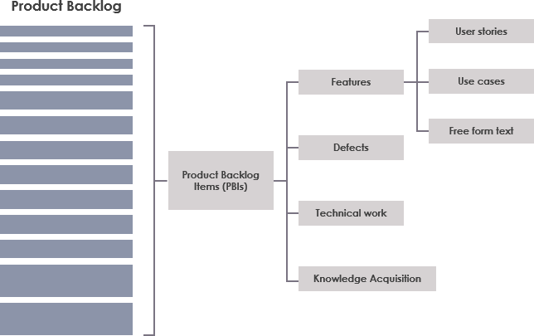
Product Backlog

Slide 62
Sprint Backlog
The Sprint Backlog is the set of Product Backlog items selected for the Sprint plus a plan for delivering the product Increment and realizing the Sprint Goal.
The Sprint Backlog is a forecast by the Development Team about what functionality will be in the next Increment and the work needed to deliver that functionality.
The Sprint Backlog defines the work the Development Team will perform to turn Product Backlog items into a “Done” Increment.
The Sprint Backlog makes visible all of the work that the Development Team identifies as necessary to meet the Sprint Goal.

Slide 63
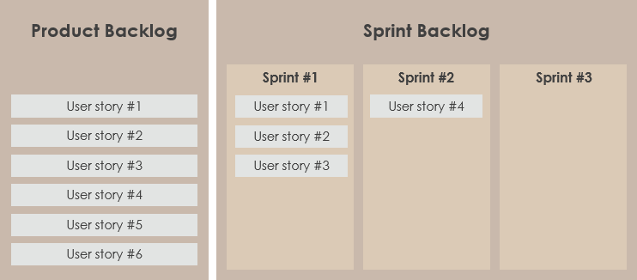
Sprint Backlog

Slide 64
Product Increment
The product increment is often thought of as the most critical of the three artifacts in Scrum. It's the version of the product that will be delivered at the end of each sprint.
While the sprint backlog outlines what must be completed within a sprint, the product increment details the outcome of all that work. The increment is a prototype, draft, or working version of the final product expected by the customer.
At the end of the initial sprint, your team will deliver product version one, including all of that sprint’s goals. At the end of the second sprint, version two will be delivered. Version two of the product increment should include all of the features and requirements already delivered in version one and any changes, new features, and requirements added in the second sprint.
Each product increment should include the features of the current sprint and fully integrate all backlog items completed to date, from all past sprints.

Slide 65
Additional Scrum Artifacts
The main Scrum artifacts help maintain smooth operations and foster collaboration.
However, there are other Scrum artifacts that each Scrum team needs to know about to improve efficiency, especially if you’re working with remote teams.
These are:
Definition of Done (DOD)
Sprint Burndown Chart

Slide 66
Definition of Done (DOD)
Each Scrum team’s definition of done is different and it depends on how they document and share their progress with internal stakeholders.
The definition of done constitutes that all aspects and tasks of a sprint backlog are complete. This is important because it defines what your product increment looks like at the end of a sprint.
Similar to product increments, the definition of done also involves multiple iterations, depending on the course of the project and the total number of backlog items completed.

Slide 67
Sprint Burndown Chart
Also known as the release burndown chart, sprint burndown charts show the remaining work in a Scrum sprint.
It’s a way of seeing whether everything is going according to plan. The tasks review helps understand whether you meet your deadlines or not.
The Scrum Master is responsible for burndown tracking and they update the chart at the end of each sprint.

Slide 68
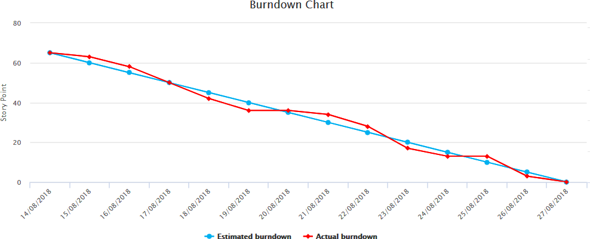
Burn down Charts
X-Axis: time (usually in days)
Y-Axis: remaining effort

Slide 69
Scrum vs XP
Scrum | Extreme Programming (XP)
In the Scrum framework, teamwork in iterations is called Sprint which is 2 weeks to 1 month long. | In Extreme Programming(XP), teamwork for 1-2 weeks only.
Scrum models do not allow changes in their timeline or their guidelines. | Extreme Programming allows changes in their set timelines.
Scrum emphasizes self-organization. | Extreme Programming emphasizes strong engineering practices
Scrum does not put emphasis on software engineering practices that developers should use. | Extreme Programming (XP) emphasizes programming techniques that developers should use to ensure a better outcome.
The tasks are prioritized by the owner of the product but with the flexibility that the priorities can be changed later on by the development team if required. | The tasks are prioritized by the customer and the task priorities cannot be changed by the development team.
Customer involvement is less in the project. | Customer involvement is more in the project.

